Slide 1

Cynhadledd Flynyddol 2023
Annual Conference 2023
Dyfodol Newydd Cymru: Cefnogi menywod i fyd technoleg
New Futures Wales: Supporting women into tech
Llais addysg bellach yng Nghymru | The voice of further education in Wales

Slide 2
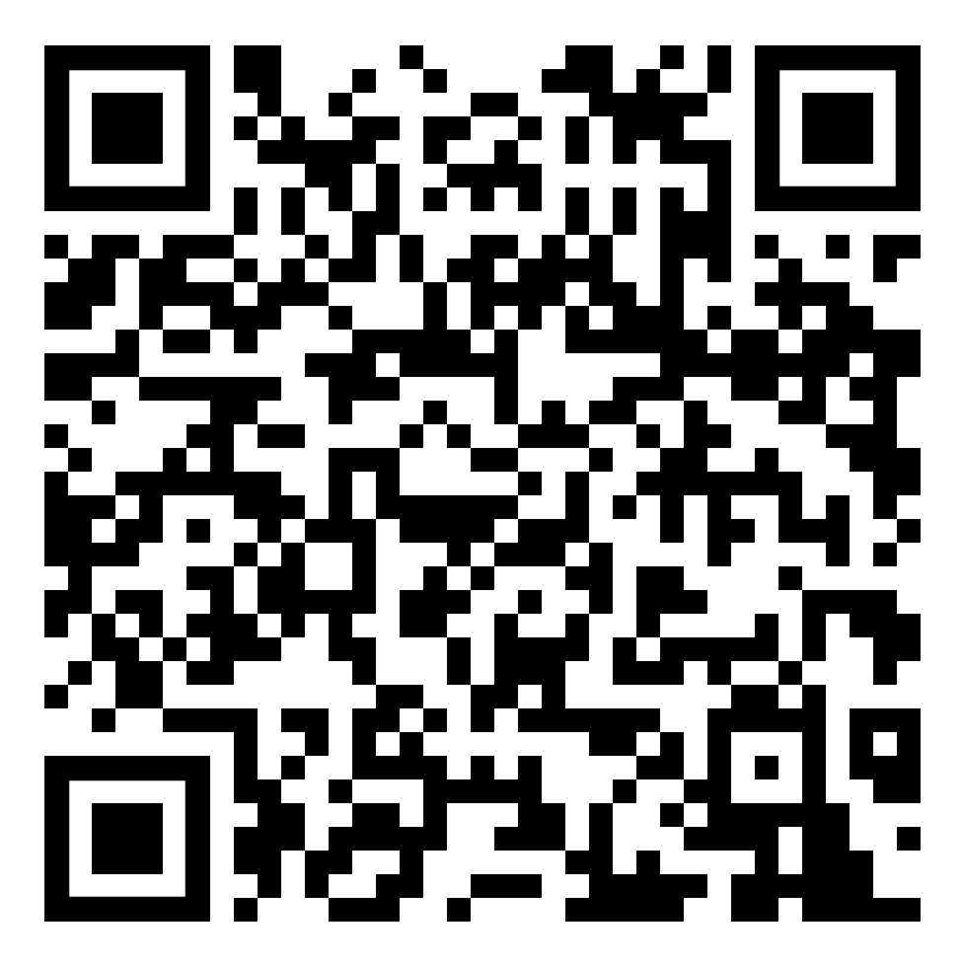

New Futures
Background and lessons
Hannah Carmichael, Learning and Work Institute

Slide 3




What is New Futures?
What?
Three-year (Jan 2021- March 2024) programme funded by the Covid-19 Support Fund (established by the Association of British Insurers) to tackle the spike in unemployment that happened as a result of the Covid-19 pandemic
Four place-based pilots in Belfast, Edinburgh, Tees Valley and Wales, providing tailored and targeted outreach activity to support workers to reskill to enable them to secure a new job in a different sector
Why?
Engage at risk workers and develop local skills provision
Understanding what works in supporting reskilling for career change
Notes:
Impacts of pandemic were not equally distributed and exacerbated previous inequalities, for example the impact was felt more in areas with high unemployment, certain sectors were more at risk and people with lower qualifications, less access to training and who were in lower paid work were more likely to have been impacted by the pandemic negatively.

Slide 4
Pilot summaries
Belfast
Lead by Belfast City Council
Make a career change to tech sector by completing a 16 week full-time tech academy
Edinburgh
Lead by Capital City Partnership
Testing flexible, person-centred careers advice and coaching
Tees Valley
Lead by Tees Valley Combined Authority
Focus on skilled and holistic careers coaching
Wales
Lead by Chwarae Teg
Supporting women to change career into the digital sector
Notes:
Local focus of pilots was particularly significant because we wanted to test what works based on local labour information, future skills needs and local skills profiles.
In Belfast, similar to Wales they identified the growing tech sector and the need to build skills to support this growth. Their approach was less flexible though and involved a 14-16 week academy that required full time classroom based learning. This proved to work well for those who could commit to it, but has it limits for those who couldn’t leave a job.
In Edinburgh the pilot supported a wide demographic with careers coaching and vocational training
In Tees Valley the approach has been similar to Edinburgh though we identified an older age group who needed targeted support in that region. A flexible fund benefitted individuals to retrain and move straight into available jobs
For Wales, we identified a need to address the skills required for the local growing tech sector, the need to address the lack of women in this sector and the negative impact the pandemic had had on women and work.

Slide 5
Highlights
HGV driver
Energy advisor (customer service)
493 people have started training to reskill
184 people have started jobs in a career that is new to them
(as at end of August 2023)
Other outcomes
Increase in confidence
Increase in motivation
Better understanding of how to look for jobs
Improvements to well-being more generally
Rigger
Software developer
Test engineer (IT)
Shop fitter
Business analyst (IT)
Scaffolder
Paint blaster
Chemical remover
Waste operative
Senior customer advisor (banking)
Bus driver
Notes:
We are now about 70% of the way through the New Futures programme and most of the pilots are coming to an end in the next few weeks. There have been lots of highlights this year, including around 500 people training to reskill and around 200 people having started new careers. You can see some examples of jobs here – a real variety. Interim evaluation findings have shown other, perhaps less obvious but hugely important outcomes like increase in confidence, motivation and general improvements to well-being.

Slide 6
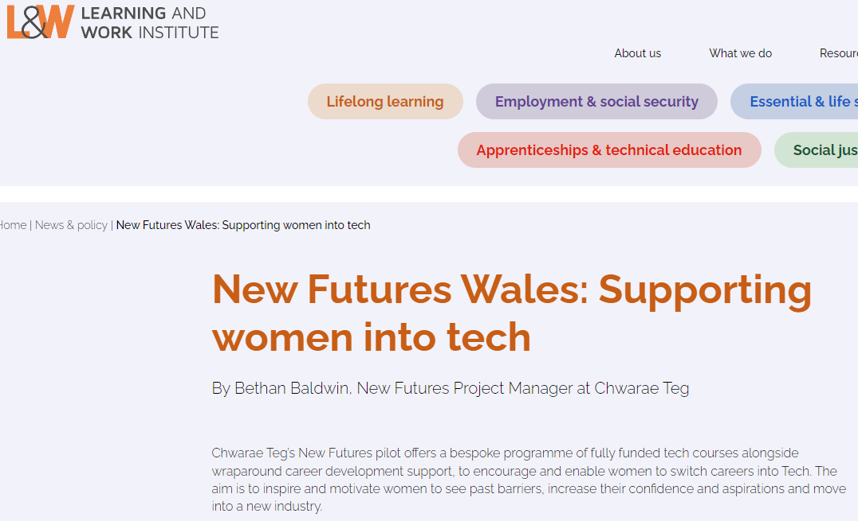
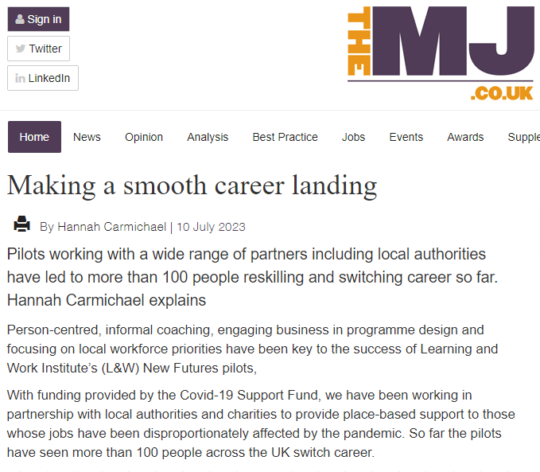
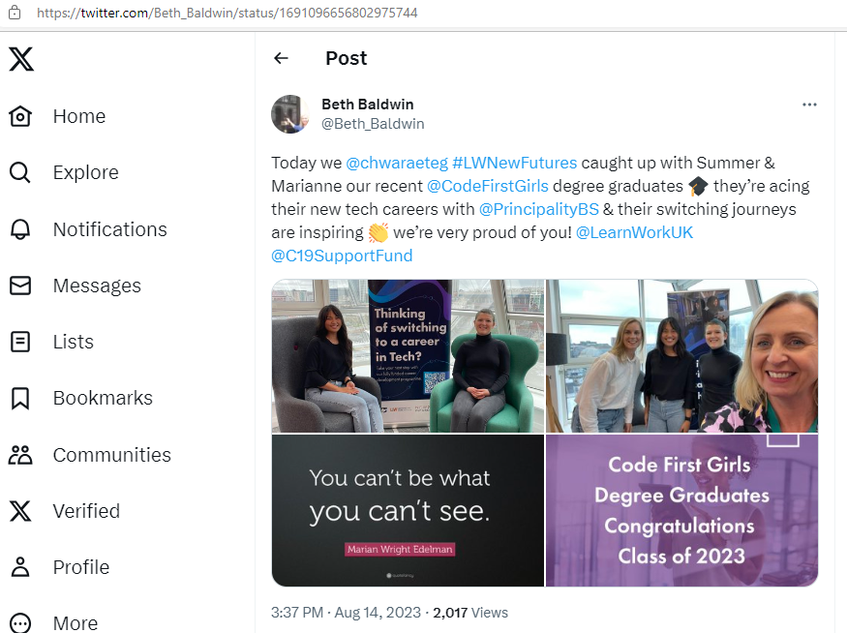
Other New Futures workstreams
Communications
Social media, local press including TV and radio, L&W website, events, briefings, blogs, meetings, and newsletters
Policy and research
Understanding and supporting reskilling and career change
Adult participation in Learning survey
Green jobs and skills
Developing policy recommendations across the four UK nations
Evaluation
Main report to be published Summer 2024
Notes:
Significant milestones (e.g. First 50 and first 150 people into new careers, pilots starting, pilots celebrating achievements)
Learning from local delivery & pilot evaluation
Policy & research programme running alongside pilots

Slide 7
Learnings so far
The New Futures pilots have identified the following as key learnings about what works for career change:
Intensive coaching – find meaningful work
Confidence building – coaching has boosted confidence and identified transferable skills that people didn’t know they had
Partnership working – working with known and new partners who have the same understanding and goals
Employer engagement – employers have a better understanding of different people and a greater willingness to think outside of the box. Also help in designing training
Preparation for work in a new environment (better transitions) – helps people to retain their new jobs
In work support – limited take up, but those who have accepted this support have benefitted in sustaining employment

Slide 8
New Futures Wales
Supporting women into tech
Bethan Baldwin, Chwarae Teg

